Slide 1
CSE 213 Computer Architecture
Lecture 8: Operating System Support
Anisur Rahman
Military Institute of Science and Technology
Notes:
Although the focus of this text is computer hardware, there is one area of software that needs to be addressed: the computer’s OS. The OS is a program that manages the computer’s resources, provides services for programmers, and schedules the execution of other programs. Some understanding of operating systems is essential to appreciate the mechanisms by which the CPU controls the computer system. In particular, explanations of the effect of interrupts and of the management of the memory hierarchy are best explained in this context.
The chapter begins with an overview and brief history of operating systems. The bulk of the chapter looks at the two OS functions that are most relevant to the study of computer organization and architecture: scheduling and memory management.

Slide 2
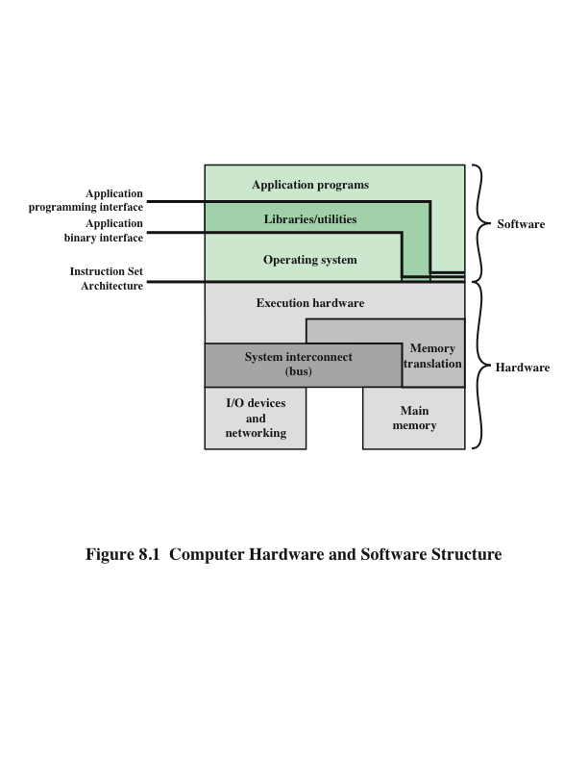
Computer Hardware and Software Structure
Notes:
An OS is a program that controls the execution of application programs and acts as an interface between applications and the computer hardware. It can be thought of as having two objectives:
• Convenience: An OS makes a computer more convenient to use.
• Efficiency: An OS allows the computer system resources to be used in an efficient manner.
The hardware and software used in providing applications to a user can be viewed in a layered or hierarchical fashion, as depicted in Figure 8.1. The user of those applications, the end user, generally is not concerned with the computer’s architecture. Thus the end user views a computer system in terms of an application. That application can be expressed in a programming language and is developed by an application programmer. To develop an application program as a set of processor instructions that is completely responsible for controlling the computer hardware would be an overwhelmingly complex task. To ease this task, a set of systems programs is provided. Some of these programs are referred to as utilities. These implement frequently used functions that assist in program creation, the management of files, and the control of I/O devices. A programmer makes use of these facilities in developing an application, and the application, while it is running, invokes the
utilities to perform certain functions.

Slide 3

Operating System (OS) Services
The most important system program
Masks the details of the hardware from the programmer and provides the programmer with a convenient interface for using the system
The OS typically provides services in the following areas:
Program creation
Program execution
Access to I/O devices
Controlled access to files
System access
Error detection and response
Accounting
Notes:
The most important system program is the OS. The OS masks the details of the hardware from the programmer and provides the programmer with a convenient interface for using the system. It acts as mediator, making it easier for the programmer and for application programs to access and use those facilities and services.
Briefly, the OS typically provides services in the following areas:
• Program creation: The OS provides a variety of facilities and services, such as editors and debuggers, to assist the programmer in creating programs. Typically, these services are in the form of utility programs that are not actually part of the OS but are accessible through the OS.
• Program execution: A number of steps need to be performed to execute a program. Instructions and data must be loaded into main memory, I/O devices and files must be initialized, and other resources must be prepared. The OS handles all of this for the user.
• Access to I/O devices: Each I/O device requires its own specific set of instructions or control signals for operation. The OS takes care of the details so that the programmer can think in terms of simple reads and writes.
• Controlled access to files: In the case of files, control must include an understanding of not only the nature of the I/O device (disk drive, tape drive) but also the file format on the storage medium. Again, the OS worries about the details. Further, in the case of a system with multiple simultaneous users, the OS can provide protection mechanisms to control access to the files.
• System access: In the case of a shared or public system, the OS controls access to the system as a whole and to specific system resources. The access function must provide protection of resources and data from unauthorized users and must resolve conflicts for resource contention.
• Error detection and response: A variety of errors can occur while a computer system is running. These include internal and external hardware errors, such as a memory error, or a device failure or malfunction; and various software errors, such as arithmetic overflow, attempt to access forbidden memory location, and inability of the OS to grant the request of an application. In each case, the OS must make the response that clears the error condition with the least impact on running applications. The response may range from ending the program that caused the error, to retrying the operation, to simply reporting the error to the application.
• Accounting: A good OS collects usage statistics for various resources and monitor performance parameters such as response time. On any system, this information is useful in anticipating the need for future enhancements and in tuning the system to improve performance. On a multiuser system, the information can be used for billing purposes.

Slide 4
Interfaces
Key interfaces in a typical computer system:
Instruction set architecture (ISA)
Defines the machine language instructions that a computer can follow
Boundary between hardware and software
Application binary interface (ABI)
Defines a standard for binary portability across programs
Defines the system call interface to the operating system and the hardware resources and services available in a system through the user ISA
Application programming interface (API)
Gives a program access to the hardware resources and services available in a system through the user ISA supplemented with high-level language (HLL) library calls
Using an API enables application software to be ported easily to other systems that support the same API
Notes:
Figure 8.1 also indicates three key interfaces in a typical computer system:
• Instruction set architecture (ISA): The ISA defines the collection of machine language instructions that a computer can follow. This interface is the boundary between hardware and software. Note that both application programs and utilities may access the ISA directly. For these programs, a subset of the instruction repertoire is available (user ISA). The OS has access to additional machine language instructions that deal with managing system resources (system ISA).
• Application binary interface (ABI): The ABI defines a standard for binary portability across programs. The ABI defines the system call interface to the operating system and the hardware resources and services available in a system through the user ISA.
• Application programming interface (API): The API gives a program access to the hardware resources and services available in a system through the user ISA supplemented with high-level language (HLL) library calls. Any system calls are usually performed through libraries. Using an API enables application software to be ported easily, through recompilation, to other systems that support the same API.

Slide 5
Operating System as Resource Manager
A computer is a set of resources for the movement, storage, and processing of data and for the control of these functions
The OS is responsible for managing these resources
The OS as a control mechanism is unusual in two respects:
The OS functions in the same way as ordinary computer software – it is a program executed by the processor
The OS frequently relinquishes control and must depend on the processor to allow it to regain control
Notes:
A computer is a set of resources for the movement, storage, and processing of data and for the control of these functions. The OS is responsible for managing these resources.
Can we say that the OS controls the movement, storage, and processing of data? From one point of view, the answer is yes: By managing the computer’s resources, the OS is in control of the computer’s basic functions. But this control is exercised in a curious way. Normally, we think of a control mechanism as something external to that which is controlled, or at least as something that is a distinct and separate part of that which is controlled. (For example, a residential heating system is controlled by a thermostat, which is completely distinct from the heat-generation and heat-distribution apparatus.) This is not the case with the OS, which as a control mechanism is unusual in two respects:
• The OS functions in the same way as ordinary computer software; that is, it is a program executed by the processor.
• The OS frequently relinquishes control and must depend on the processor to allow it to regain control.
Like other computer programs, the OS provides instructions for the processor. The key difference is in the intent of the program. The OS directs the processor in the use of the other system resources and in the timing of its execution of other programs. But in order for the processor to do any of these things, it must cease executing the OS program and execute other programs. Thus, the OS relinquishes control for the processor to do some “useful” work and then resumes control long enough to prepare the processor to do the next piece of work. The mechanisms
involved in all this should become clear as the chapter proceeds.

Slide 6
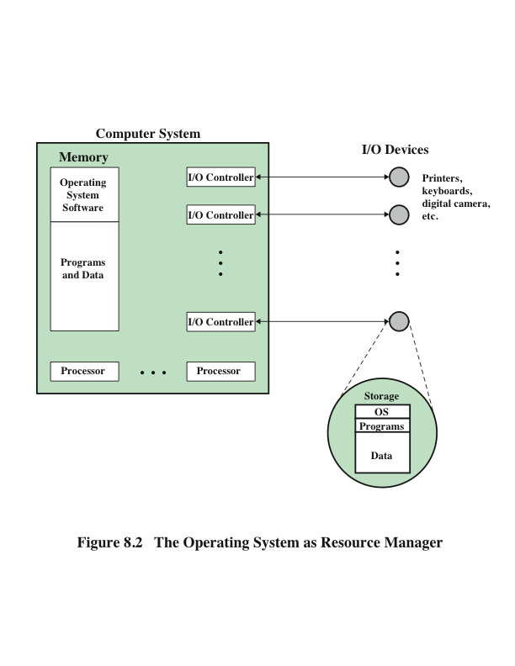
The OS as Resource Manager
Notes:
Figure 8.2 suggests the main resources that are managed by the OS. A portion of the OS is in main memory. This includes the kernel, or nucleus, which contains the most frequently used functions in the OS and, at a given time, other portions of the OS currently in use. The remainder of main memory contains user programs and data. The allocation of this resource (main memory) is controlled jointly by the OS
and memory-management hardware in the processor, as we shall see. The OS decides when an I/O device can be used by a program in execution, and controls access to and use of files. The processor itself is a resource, and the OS must determine how much processor time is to be devoted to the execution of a particular user program. In the case of a multiple-processor system, this decision must span all of the processors.

Slide 7
Types of Operating Systems
Interactive system
The user/programmer interacts directly with the computer to request the execution of a job or to perform a transaction
User may, depending on the nature of the application, communicate with the computer during the execution of the job
Batch system
Opposite of interactive
The user’s program is batched together with programs from other users and submitted by a computer operator
After the program is completed results are printed out for the user
Notes:
Certain key characteristics serve to differentiate various types of operating systems. The characteristics fall along two independent dimensions. The first dimension specifies whether the system is batch or interactive. In an interactive system, the user/programmer interacts directly with the computer, usually through a keyboard/ display terminal, to request the execution of a job or to perform a transaction. Furthermore, the user may, depending on the nature of the application, communicate with the computer during the execution of the job. A batch system is the
opposite of interactive. The user’s program is batched together with programs from other users and submitted by a computer operator. After the program is completed, results are printed out for the user. Pure batch systems are rare today. However, it will be useful to the description of contemporary operating systems to examine batch systems briefly.
An independent dimension specifies whether the system employs multiprogramming or not. With multiprogramming, the attempt is made to keep the processor as busy as possible, by having it work on more than one program at a time. Several programs are loaded into memory, and the processor switches rapidly among them. The alternative is a uniprogramming system that works only one program at a time.

Slide 8
Early Systems
From the late 1940s to the mid-1950s the programmer interacted directly with the computer hardware – there was no OS
Processors were run from a console consisting of display lights, toggle switches, some form of input device and a printer
Problems:
Scheduling
Sign-up sheets were used to reserve processor time
This could result in wasted computer idle time if the user finished early
If problems occurred the user could be forced to stop before resolving the problem
Setup time
A single program could involve
Loading the compiler plus the source program into memory
Saving the compiled program
Loading and linking together the object program and common functions
Notes:
With the earliest computers, from the late 1940s to the mid-1950s, the programmer interacted directly with the computer hardware; there was no OS. These processors were run from a console, consisting of display lights, toggle switches, some form of input device, and a printer. Programs in processor code were loaded via the input device (e.g., a card reader). If an error halted the program, the error condition was indicated by the lights. The programmer could proceed to examine registers and main memory to determine the cause of the error. If the program proceeded to a normal completion, the output appeared on the printer.
These early systems presented two main problems:
• Scheduling: Most installations used a sign-up sheet to reserve processor time. Typically, a user could sign up for a block of time in multiples of a half hour or so. A user might sign up for an hour and finish in 45 minutes; this would result in wasted computer idle time. On the other hand, the user might run into problems, not finish in the allotted time, and be forced to stop before resolving
the problem.
• Setup time: A single program, called a job, could involve loading the compiler plus the high-level language program (source program) into memory, saving the compiled program (object program), and then loading and linking together the object program and common functions. Each of these steps could involve mounting or dismounting tapes, or setting up card decks. If an error occurred, the hapless user typically had to go back to the beginning of the setup sequence. Thus a considerable amount of time was spent just in setting up the program to run.
This mode of operation could be termed serial processing, reflecting the fact that users have access to the computer in series. Over time, various system software tools were developed to attempt to make serial processing more efficient. These include libraries of common functions, linkers, loaders, debuggers, and I/O driver routines that were available as common software for all users.

Slide 9
Generation of Computers
First Generation (1940-1956) Vacuum Tubes
UNIVAC and ENIAC computers ( used vacuum tubes )
Second Generation (1956-1963) Transistors
Early versions of COBOL and FORTRAN (used punch card)
Third Generation (1964-1971) Integrated Circuits
keyboards, monitors and interfaced with an operating system
Fourth Generation (1971-Present) Microprocessors
Development of GUIs, the mouse and handheld devices.
Fifth Generation (Present and Beyond) Artificial Intelligence
voice recognition, parallel processing, Quantum computation, nanotechnology

Slide 10
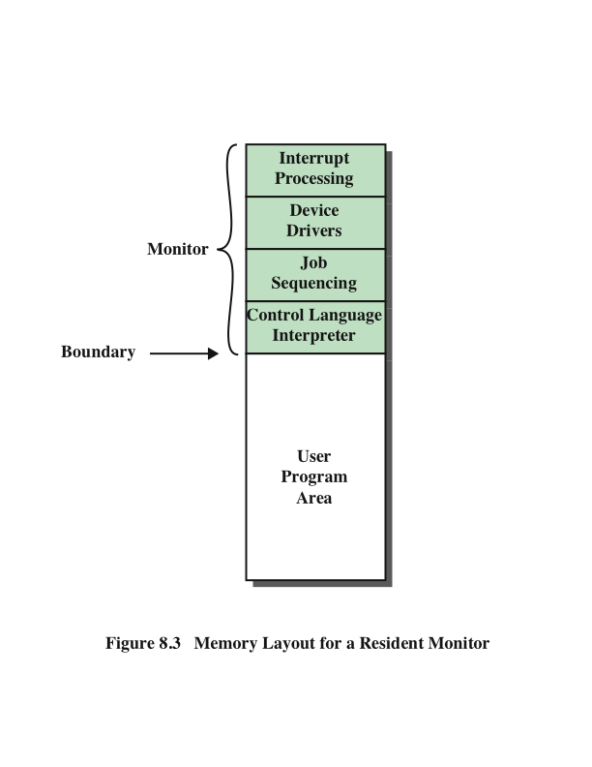
Memory Layout for a Resident Monitor
Notes:
Early processors were very expensive, and therefore it was important to maximize processor utilization. The wasted time due to scheduling
and setup time was unacceptable.
To improve utilization, simple batch operating systems were developed. With such a system, also called a monitor, the user no longer has direct access to the processor. Rather, the user submits the job on cards or tape to a computer operator, who batches the jobs together sequentially and places the entire batch on an input device, for use by the monitor.
To understand how this scheme works, let us look at it from two points of view: that of the monitor and that of the processor. From the point of view of the monitor, the monitor controls the sequence of events. For this to be so, much of the monitor must always be in main memory and available for execution (Figure 8.3). That portion is referred to as the resident monitor. The rest of the monitor consists of utilities and common functions that are loaded as subroutines to the user program at the beginning of any job that requires them. The monitor reads in jobs one at a time from the input device (typically a card reader or magnetic tape drive). As it is read in, the current job is placed in the user program area, and control is passed to this job. When the job is completed, it returns control to the monitor, which immediately reads in the next job. The results of each job are printed out for delivery to the user.

Slide 11
From the View of the Processor . . .
Processor executes instructions from the portion of main memory containing the monitor
These instructions cause the next job to be read in another portion of main memory
The processor executes the instruction in the user’s program until it encounters an ending or error condition
Either event causes the processor to fetch its next instruction from the monitor program
The monitor handles setup and scheduling
A batch of jobs is queued up and executed as rapidly as possible with no idle time
Job control language (JCL)
Special type of programming language used to provide instructions to the monitor
Example:
$JOB
$FTN
... Some Fortran instructions
$LOAD
$RUN
... Some data
$END
Monitor, or batch OS, is simply a computer program
It relies on the ability of the processor to fetch instructions from various portions of main memory in order to seize and relinquish control alternately
**Each FORTRAN instruction and each item of
data is on a separate punched card or a separate record on tape. In addition to FORTRAN and data lines, the job includes job control instructions, which are
denoted by the beginning “$”.
Notes:
Now consider this sequence from the point of view of the processor. At a certain point in time, the processor is executing instructions from the portion of main memory containing the monitor. These instructions cause the next job to be read in to another portion of main memory. Once a job has been read in, the processor will encounter in the monitor a branch instruction that instructs the processor to continue execution at the start of the user program. The processor will then execute the instruction in the user’s program until it encounters an ending or error condition.
Either event causes the processor to fetch its next instruction from the monitor program. Thus the phrase “control is passed to a job” simply means that the processor is now fetching and executing instructions in a user program, and “control is returned to the monitor” means that the processor is now fetching and executing instructions from the monitor program.
It should be clear that the monitor handles the scheduling problem. A batch of jobs is queued up, and jobs are executed as rapidly as possible, with no intervening idle time.
How about the job setup time? The monitor handles this as well. With each. job, instructions are included in a job control language (JCL). This is a special type of programming language used to provide instructions to the monitor. A simple example is that of a user submitting a program written in FORTRAN plus some data to be used by the program. Each FORTRAN instruction and each item of data is on a separate punched card or a separate record on tape. In addition to FORTRAN and data lines, the job includes job control instructions, which are
denoted by the beginning “$”.
To execute this job, the monitor reads the $FTN line and loads the appropriate compiler from its mass storage (usually tape). The compiler translates the user’s program into object code, which is stored in memory or mass storage. If it is stored in memory, the operation is referred to as “compile, load, and go.” If it is stored on tape, then the $LOAD instruction is required. This instruction is read by the monitor, which regains control after the compile operation. The monitor invokes the loader, which loads the object program into memory in place of the compiler
and transfers control to it. In this manner, a large segment of main memory can be shared among different subsystems, although only one such subsystem could be resident and executing at a time.
We see that the monitor, or batch OS, is simply a computer program. It relies on the ability of the processor to fetch instructions from various portions of main memory in order to seize and relinquish control alternately.

Slide 12
Desirable Hardware Features
Memory protection
User program must not alter the memory area containing the monitor
The processor hardware should detect an error and transfer control to the monitor
The monitor aborts the job, prints an error message, and loads the next job
Privileged instructions
Can only be executed by the monitor
If the processor encounters such an instruction while executing a user program an error interrupt occurs
I/O instructions are privileged so the monitor retains control of all I/O devices
Timer
Used to prevent a job from monopolizing the system
If the timer expires an interrupt occurs and control returns to monitor
Interrupts
Gives the OS more flexibility in relinquishing control to and regaining control from user programs
Notes:
Certain other hardware features are also desirable:
• Memory protection: While the user program is executing, it must not alter the memory area containing the monitor. If such an attempt is made, the processor hardware should detect an error and transfer control to the monitor. The monitor would then abort the job, print out an error message, and load the next job.
• Timer: A timer is used to prevent a single job from monopolizing the system. The timer is set at the beginning of each job. If the timer expires, an interrupt occurs, and control returns to the monitor.
• Privileged instructions: Certain instructions are designated privileged and can be executed only by the monitor. If the processor encounters such an instruction while executing a user program, an error interrupt occurs. Among the privileged instructions are I/O instructions, so that the monitor retains control of all I/O devices. This prevents, for example, a user program from accidentally reading job control instructions from the next job. If a user program wishes to perform I/O, it must request that the monitor perform the operation for it. If a privileged instruction is encountered by the processor while it is executing a user program, the processor hardware considers this an error and transfers control to the monitor.
• Interrupts: Early computer models did not have this capability. This feature gives the OS more flexibility in relinquishing control to and regaining control from user programs.
Processor time alternates between execution of user programs and execution of the monitor. There have been two sacrifices: Some main memory is now given over to the monitor and some processor time is consumed by the monitor. Both of these are forms of overhead. Even with this overhead, the simple batch system improves utilization of the computer.

Slide 13
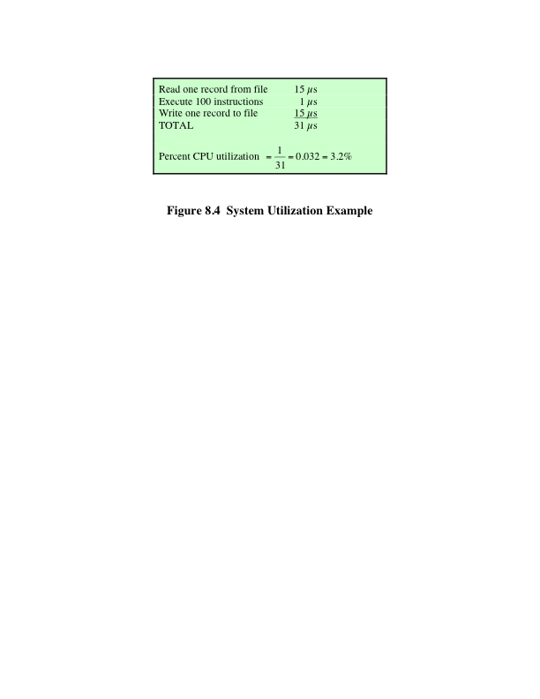
System Utilization Example
Notes:
Even with the automatic job sequencing provided by a simple batch OS, the processor is often idle. The problem is that I/O devices are slow compared to the processor. Figure 8.4 details a representative calculation. The calculation concerns a program that processes a file of records and performs, on average, 100 processor instructions per record. In this example the computer spends over 96% of its time waiting for I/O devices to finish transferring data! Figure 8.5a illustrates this situation.

Slide 14
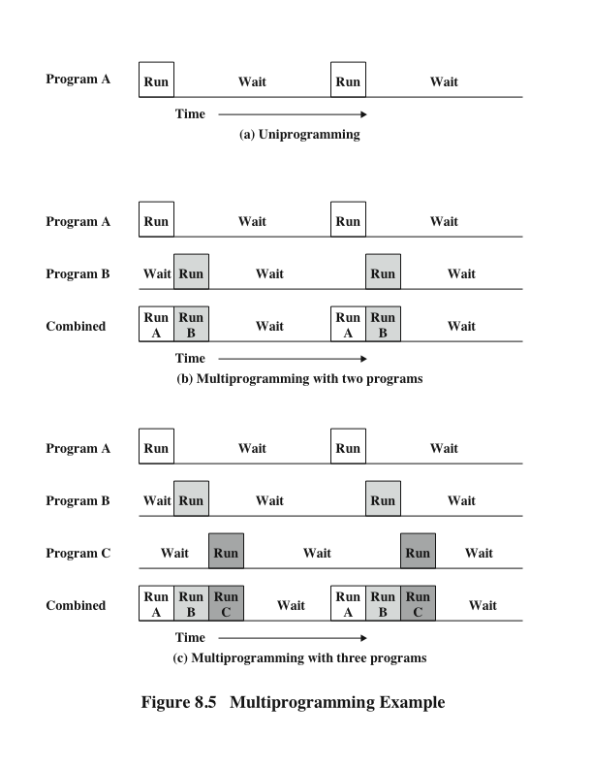
Multiprogramming Example
Notes:
The processor spends a certain amount of time executing, until it reaches an I/O instruction. It must then wait until that I/O instruction concludes before proceeding.
This inefficiency is not necessary. We know that there must be enough memory to hold the OS (resident monitor) and one user program. Suppose that there is room for the OS and two user programs. Now, when one job needs to wait for I/O, the processor can switch to the other job, which likely is not waiting for I/O (Figure 8.5b). Furthermore, we might expand memory to hold three, four, or more programs and switch among all of them (Figure 8.5c). This technique is known as multiprogramming, or multitasking. It is the central theme of modern operating systems.
As with a simple batch system, a multiprogramming batch system must rely on certain computer hardware features. The most notable additional feature that is useful for multiprogramming is the hardware that supports I/O interrupts and DMA. With interrupt-driven I/O or DMA, the processor can issue an I/O command for one job and proceed with the execution of another job while the I/O is carried out by the device controller. When the I/O operation is complete, the processor is interrupted and control is passed to an interrupt-handling program in the OS. The OS will then pass control to another job.

Slide 15
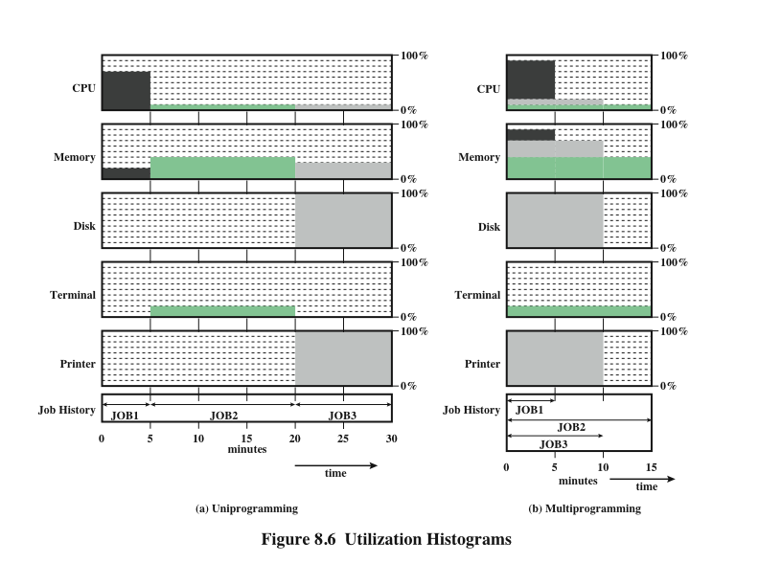
Notes:
Multiprogramming operating systems are fairly sophisticated compared to single-program, or uniprogramming, systems. To have several jobs ready to run, the jobs must be kept in main memory, requiring some form of memory management. In addition, if several jobs are ready to run, the processor must decide which one to run, which requires some algorithm for scheduling. These concepts are discussed
later in this chapter.

Slide 16
Time Sharing Systems
Used when the user interacts directly with the computer
Processor’s time is shared among multiple users
Multiple users simultaneously access the system through terminals, with the OS interleaving the execution of each user program in a short burst or quantum of computation
Example:
If there are n users actively requesting service at one time, each user will only see on the average 1/n of the effective computer speed
Notes:
With the use of multiprogramming, batch processing can be quite efficient. However, for many jobs, it is desirable to provide a mode in
which the user interacts directly with the computer. Indeed, for some jobs, such as transaction processing, an interactive mode is essential.
Today, the requirement for an interactive computing facility can be, and often is, met by the use of a dedicated microcomputer. That option was not available in the 1960s, when most computers were big and costly. Instead, time sharing was developed.
Just as multiprogramming allows the processor to handle multiple batch jobs at a time, multiprogramming can be used to handle multiple interactive jobs. In this latter case, the technique is referred to as time sharing, because the processor’s time is shared among multiple users. In a time-sharing system, multiple users simultaneously access the system through terminals, with the OS interleaving the execution of each user program in a short burst or quantum of computation. Thus, if there are n users actively requesting service at one time, each user will only see on the average 1/n of the effective computer speed, not counting OS overhead. However, given the relatively slow human reaction time, the response time on a properly designed system should be comparable to that on a dedicated computer.

Slide 17
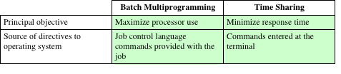
Batch
Multiprogramming
versus
Time Sharing
Notes:
Both batch multiprogramming and time sharing use multiprogramming. The key differences are listed in Table 8.3.

Slide 18
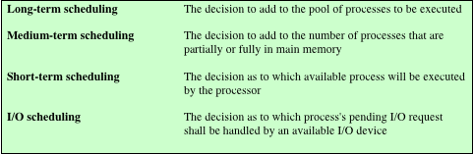
Scheduling(Note Copy)
The key to multiprogramming
Four types are typically involved:
Table 8.4 Types of Scheduling
Notes:
The key to multiprogramming is scheduling. In fact, four types of scheduling are typically involved (Table 8.4). We will explore these presently. But first, we introduce the concept of process. This term was first used by the designers of the Multics OS in the 1960s. It is a somewhat more general term than job. Many definitions have been given for the term process, including
• A program in execution
• The “animated spirit” of a program
• That entity to which a processor is assigned

Slide 19
Long Term Scheduling
Determines which programs are submitted for processing
Once submitted, a job becomes a process for the short term scheduler
In some systems a newly created process begins in a swapped-out condition, in which case it is added to a queue for the medium-term scheduler
Batch system
Newly submitted jobs are routed to disk and held in a batch queue
The long-term scheduler creates processes from the queue when it can
Time-sharing system
A process request is generated when a user attempts to connect to the system
OS will accept all authorized comers until the system is saturated
At that point a connection request is met with a message indicating that the system is full and to try again later
Notes:
The long-term scheduler determines which programs are admitted to the system for processing. Thus, it controls the degree of multiprogramming (number of processes in memory). Once admitted, a job or user program becomes a process and is added to the queue for the short-term scheduler. In some systems, a newly created process begins in a swapped-out condition, in which case it is added to a queue for the medium-term scheduler.
In a batch system, or for the batch portion of a general-purpose OS, newly submitted jobs are routed to disk and held in a batch queue. The long-term scheduler creates processes from the queue when it can. There are two decisions involved here. First, the scheduler must decide that the OS can take on one or more additional processes. Second, the scheduler must decide which job or jobs to accept and turn into processes. The criteria used may include priority, expected execution time, and I/O requirements.
For interactive programs in a time-sharing system, a process request is generated when a user attempts to connect to the system. Time-sharing users are not simply queued up and kept waiting until the system can accept them. Rather, the OS will accept all authorized comers until the system is saturated, using some predefined measure of saturation. At that point, a connection request is met with a message indicating that the system is full and the user should try again later.

Slide 20
Medium-Term Scheduling and Short-Term Scheduling
Medium-Term
Short-Term
Part of the swapping function
Swapping-in decision is based on the need to manage the degree of multiprogramming
Swapping-in decision will consider the memory requirements of the swapped-out processes
Also known as the dispatcher
Executes frequently and makes the fine-grained decision of which job to execute next
Notes:
Medium-term scheduling is part of the swapping function, described in Section 8.3.
Typically, the swapping-in decision is based on the need to manage the degree of multiprogramming. On a system that does not use virtual memory, memory management is also an issue. Thus, the swapping-in decision will consider the memory requirements of the swapped-out processes.
The long-term scheduler executes relatively infrequently and makes the coarse grained decision of whether or not to take on a new process, and which one to take. The short-term scheduler, also known as the dispatcher, executes frequently and makes the fine-grained decision of which job to execute next.

Slide 21
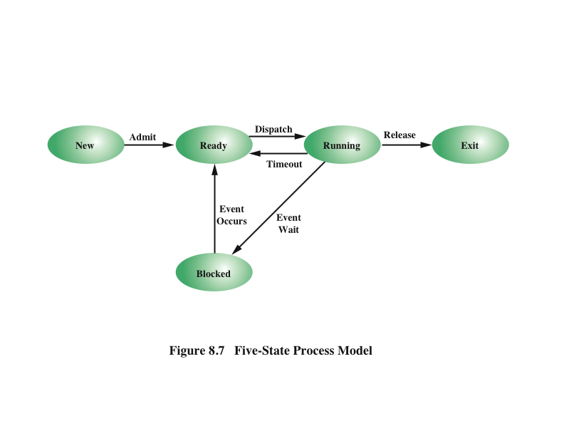
Five State Process Model
Notes:
To understand the operation of the short-term scheduler, we need to consider the concept of a process state. During the lifetime of a process, its status will change a number of times. Its status at any point in time is referred to as a state. The term state is used because it connotes that certain information exists that defines the status at that point. At minimum, there are five defined states for a process (Figure 8.7):
• New: A program is admitted by the high-level scheduler but is not yet ready to execute. The OS will initialize the process, moving it to the ready state.
• Ready: The process is ready to execute and is awaiting access to the processor.
• Running: The process is being executed by the processor.
• Waiting: The process is suspended from execution waiting for some system resource, such as I/O.
• Halted: The process has terminated and will be destroyed by the OS.

Slide 22
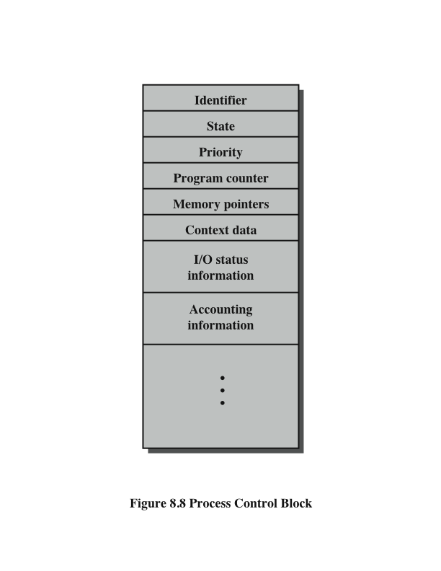
Process Control Block
Notes:
For each process in the system, the OS must maintain information indicating the state of the process and other information necessary for process execution. For this purpose, each process is represented in the OS by a process control block (Figure 8.8), which typically contains
• Identifier: Each current process has a unique identifier.
• State: The current state of the process (new, ready, and so on).
• Priority: Relative priority level.
• Program counter: The address of the next instruction in the program to be executed.
• Memory pointers: The starting and ending locations of the process in memory.
• Context data: These are data that are present in registers in the processor while the process is executing, and they will be discussed in Part Three. For now, it is enough to say that these data represent the “context” of the process. The context data plus the program counter are saved when the process leaves the running state. They are retrieved by the processor when it resumes execution of the process.
• I/O status information: Includes outstanding I/O requests, I/O devices (e.g., tape drives) assigned to this process, a list of files assigned to the process, and so on.
• Accounting information: May include the amount of processor time and clock time used, time limits, account numbers, and so on.
When the scheduler accepts a new job or user request for execution, it creates a blank process control block and places the associated process in the new state. After the system has properly filled in the process control block, the process is transferred to the ready state.

Slide 23
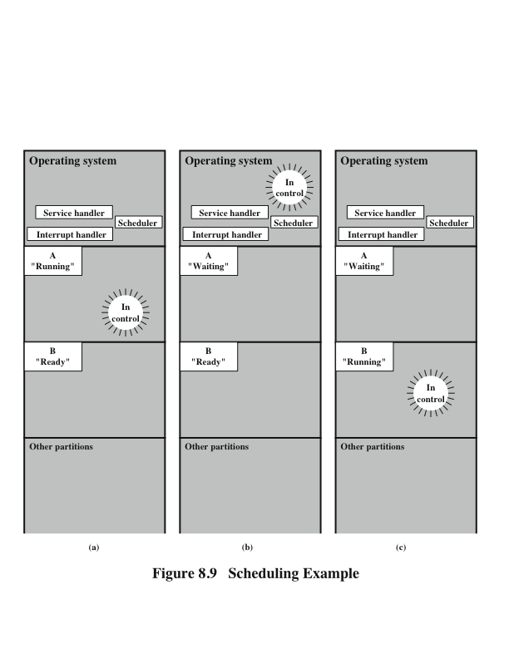
Scheduling Example
Notes:
To understand how the OS manages the scheduling of the various jobs in memory, let us begin by considering the simple example in Figure 8.9. The figure shows how main memory is partitioned at a given point in time. The kernel of the OS is, of course, always resident. In addition, there are a number of active processes, including A and B, each of which is allocated a portion of memory.
We begin at a point in time when process A is running. The processor is executing instructions from the program contained in A’s memory partition. At some later point in time, the processor ceases to execute instructions in A and begins executing instructions in the OS area. This will happen for one of three reasons:
1. Process A issues a service call (e.g., an I/O request) to the OS. Execution of A is suspended until this call is satisfied by the OS.
2. Process A causes an interrupt. An interrupt is a hardware-generated signal to the processor. When this signal is detected, the processor ceases to execute A and transfers to the interrupt handler in the OS. A variety of events related to A will cause an interrupt. One example is an error, such as attempting to execute a privileged instruction. Another example is a timeout; to prevent any one process from monopolizing the processor, each process is only granted the processor for a short period at a time.
3. Some event unrelated to process A that requires attention causes an interrupt. An example is the completion of an I/O operation.
In any case, the result is the following. The processor saves the current context data and the program counter for A in A’s process control block and then begins executing in the OS. The OS may perform some work, such as initiating an I/O operation. Then the short-term-scheduler portion of the OS decides which process should be executed next. In this example, B is chosen. The OS instructs the processor
to restore B’s context data and proceed with the execution of B where it left off.

Slide 24
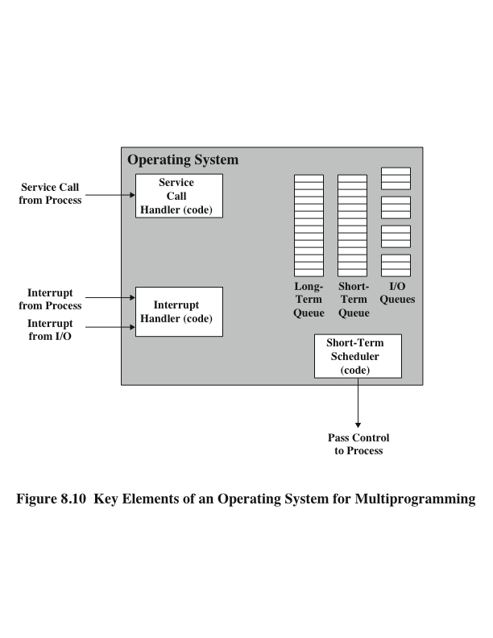
Key Elements of O/S
Notes:
This simple example highlights the basic functioning of the short-term scheduler. Figure 8.10 shows the major elements of the OS involved in the multiprogramming and scheduling of processes. The OS receives control of the processor at the interrupt handler if an interrupt occurs and at the service-call handler if a service call occurs. Once the interrupt or service call is handled, the short-term scheduler is invoked to select a process for execution.
To do its job, the OS maintains a number of queues. Each queue is simply a waiting list of processes waiting for some resource. The long-term queue is a list of jobs waiting to use the system. As conditions permit, the high-level scheduler will allocate memory and create a process for one of the waiting items. The short-term queue consists of all processes in the ready state. Any one of these processes could use the processor next. It is up to the short-term scheduler to pick one. Generally, this is done with a round-robin algorithm, giving each process some time in turn. Priority levels may also be used. Finally, there is an I/O queue for each I/O device. More than one process may request the use of the same I/O device. All processes waiting to use each device are lined up in that device’s queue.

Slide 25
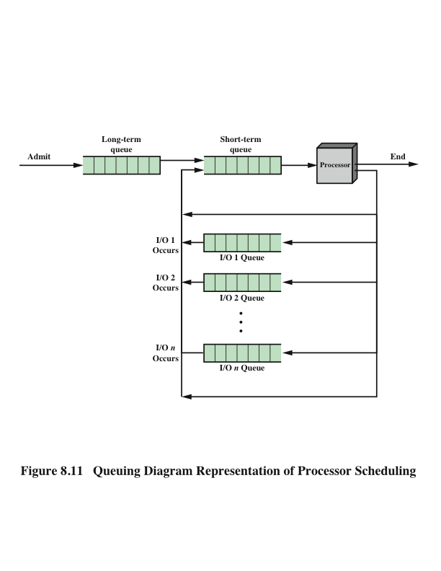
Process Scheduling
Notes:
Figure 8.11 suggests how processes progress through the computer under the control of the OS. Each process request (batch job, user-defined interactive job) is placed in the long-term queue. As resources become available, a process request becomes a process and is then placed in the ready state and put in the short-term queue. The processor alternates between executing OS instructions and executing user processes. While the OS is in control, it decides which process in the short-term queue should be executed next. When the OS has finished its immediate tasks, it turns the processor over to the chosen process.
As was mentioned earlier, a process being executed may be suspended for a variety of reasons. If it is suspended because the process requests I/O, then it is placed in the appropriate I/O queue. If it is suspended because of a timeout or because the OS must attend to pressing business, then it is placed in the ready state and put into the short-term queue.
Finally, we mention that the OS also manages the I/O queues. When an I/O operation is completed, the OS removes the satisfied process from that I/O queue and places it in the short-term queue. It then selects another waiting process (if any) and signals for the I/O device to satisfy that process’s request.

Slide 26
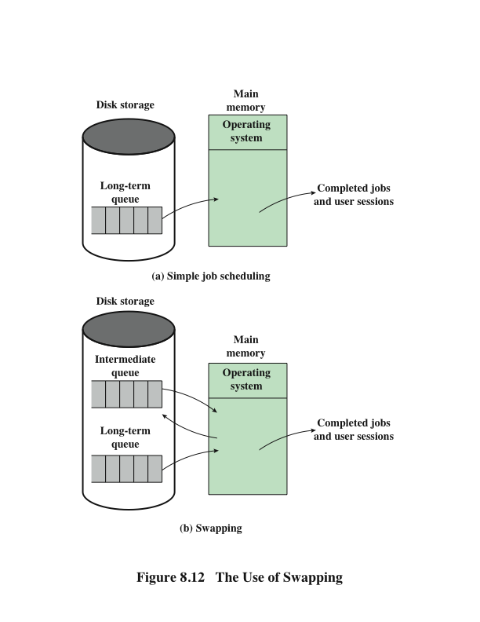
Memory Management
Swapping
Notes:
Main memory could be expanded, and so be able to accommodate more processes. But there are two flaws in this approach. First, main memory is expensive, even today. Second, the appetite of programs for memory has grown as fast as the cost of memory has dropped. So larger memory results in larger processes, not more processes.
Another solution is swapping, depicted in Figure 8.12. We have a long-term queue of process requests, typically stored on disk. These are brought in, one at a time, as space becomes available. As processes are completed, they are moved out of main memory. Now the situation will arise that none of the processes in memory are in the ready state (e.g., all are waiting on an I/O operation). Rather than remain idle, the processor swaps one of these processes back out to disk into an intermediate queue. This is a queue of existing processes that have been temporarily kicked out of memory. The OS then brings in another process from the intermediate queue, or it honors a new process request from the long-term queue. Execution then continues with the newly arrived process.
Swapping, however, is an I/O operation, and therefore there is the potential for making the problem worse, not better. But because disk I/O is generally the fastest I/O on a system (e.g., compared with tape or printer I/O), swapping will usually enhance performance. A more sophisticated scheme, involving virtual memory, improves performance over simple swapping. This will be discussed shortly. But first, we must prepare the ground by explaining partitioning and paging.

Slide 27
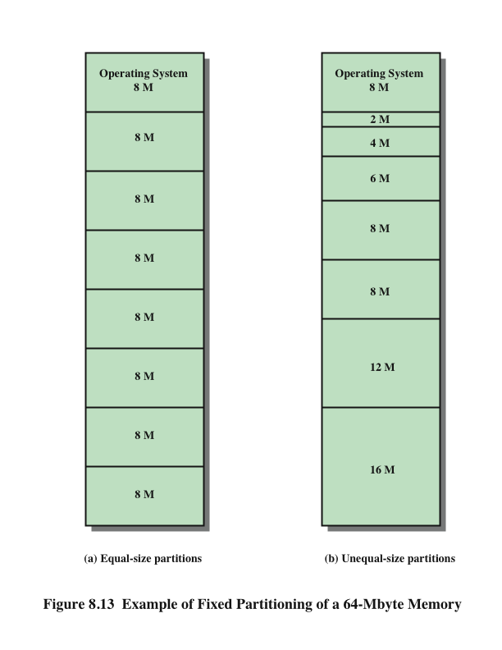
Memory Management
Partitioning
Notes:
The simplest scheme for partitioning available memory is to use fixed-size partitions, as shown in Figure 8.13(a). Note that, although the partitions are of fixed size, they need not be of equal size. When a process is brought into memory, it is placed in the smallest available partition that will hold it.
Even with the use of unequal fixed-size partitions, there will be wasted memory. In most cases, a process will not require exactly as much memory as provided by the partition. For example, a process that requires 3M bytes of memory would be placed in the 4M partition of Figure 8.13b, wasting 1M that could be used by another process.
A more efficient approach is to use variable-size partitions. When a process is brought into memory, it is allocated exactly as much memory as it requires and no more.

Slide 28
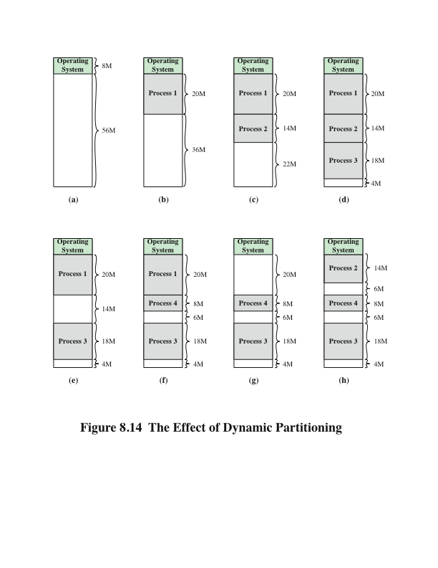
Effect of Dynamic Partitioning
Logical address
- expressed as a location relative to the
beginning of the program
Physical address
- an actual location in main memory
Base address
- current starting location of the process
Notes:
Before we consider ways of dealing with the shortcomings of partitioning, we must clear up one loose end. Consider Figure 8.14; it should be obvious that a process is not likely to be loaded into the same place in main memory each time it is swapped in. Furthermore, if compaction is used, a process may be shifted while in main memory. A process in memory consists of instructions plus data. The instructions will contain addresses for memory locations of two types:
• Addresses of data items
• Addresses of instructions, used for branching instructions
But these addresses are not fixed. They will change each time a process is swapped in. To solve this problem, a distinction is made between logical addresses and physical addresses. A logical address is expressed as a location relative to the beginning of the program. Instructions in the program contain only logical addresses. A physical address is an actual location in main memory. When the processor executes
a process, it automatically converts from logical to physical address by adding the current starting location of the process, called its base address, to each logical address. This is another example of a processor hardware feature designed to meet an OS requirement. The exact nature of this hardware feature depends on the memory management strategy in use. We will see several examples later in this chapter.

Slide 29
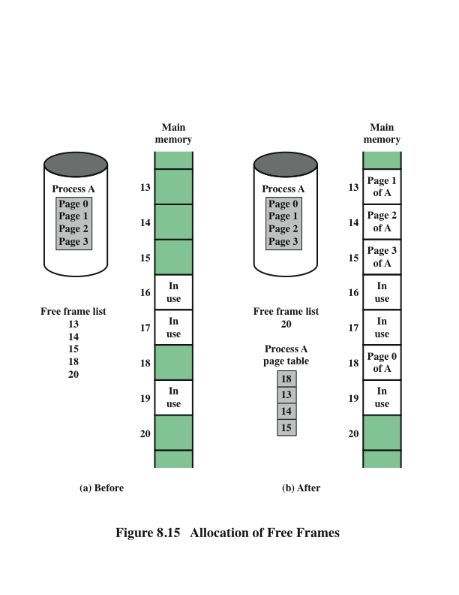
Memory Management
Paging
Notes:
Both unequal fixed-size and variable-size partitions are inefficient in the use of memory. Suppose, however, that memory is partitioned into equal fixed-size chunks that are relatively small, and that each process is also divided into small fixed-size chunks of some size. Then the chunks of a program, known as pages, could be assigned to available chunks of memory, known as frames, or page frames. At most,
then, the wasted space in memory for that process is a fraction of the last page. Figure 8.15 shows an example of the use of pages and frames. At a given point in time, some of the frames in memory are in use and some are free. The list of free frames is maintained by the OS. Process A, stored on disk, consists of four pages. When it comes time to load this process, the OS finds four free frames and loads the four pages of the process A into the four frames.

Slide 30
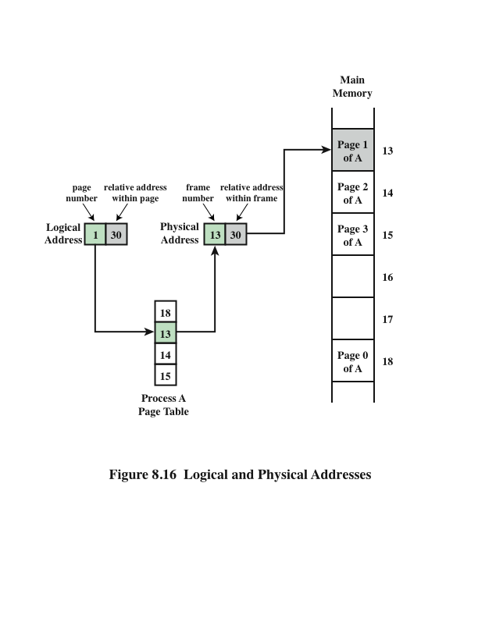
Logical and Physical Addresses Paging
Notes:
Now suppose, as in this example, that there are not sufficient unused contiguous frames to hold the process. Does this prevent the OS from loading A? The answer is no, because we can once again use the concept of logical address. A simple base address will no longer suffice. Rather, the OS maintains a page table for each process. The page table shows the frame location for each page of the process. Within the program, each logical address consists of a page number and a relative address within the page. Recall that in the case of simple partitioning, a
logical address is the location of a word relative to the beginning of the program; the processor translates that into a physical address. With paging, the logical-to- physical address translation is still done by processor hardware. The processor must know how to access the page table of the current process. Presented with a logical address (page number, relative address), the processor uses the page table to produce a physical address (frame number, relative address). An example is shown in Figure 8.16.
This approach solves the problems raised earlier. Main memory is divided into many small equal-size frames. Each process is divided into frame-size pages: smaller processes require fewer pages, larger processes require more. When a process is brought in, its pages are loaded into available frames, and a page table is set up.

Slide 31
Logical and Physical Addresses
Newer x86 chips support segmentation only in 32-bit mode
Paging generally makes life simpler for operating system and CPU designers, and therefore is much more common than segmentation.
Most RISC chips don’t support it at all.
Paging
Notes:
Paging generally makes life simpler for operating system and CPU designers, and therefore is much more common than segmentation. Newer x86 chips support segmentation only in 32-bit mode, and most RISC chips don’t support it at all. This is something of a shame, since segmentation can be very useful to programmers if exposed through the language they use, but that option is quite rare.
One additional mechanism was proposed in recent years, known as Mondrian memory protection. This approach separates the protection and translation operations of an MMU. The translation portion is performed via paging (or not at all). Protection is implemented through an efficient mechanism that permits byte-granularity permissions to be defined. Sadly, this technique hasn’t been incorporated into any commercial CPUs (yet).

Slide 32
Logical and Physical Addresses
One additional mechanism was proposed in recent years, known as Mondrian memory protection.
This approach separates the protection and translation operations of an MMU.
The translation portion is performed via paging.
Protection is implemented through an efficient mechanism that permits byte-granularity permissions to be defined.
Protection of Paging
Notes:
Mondrian memory protection is a technique that extends the traditional memory protection scheme and allows ﬁne-grain permission settings. More precisely, instead of being able to set access permissions on a page-level, Mondrian memory protection supports different access permissions for individual words. However, Mondrian memory protection is still limited to only two permission bits with a predeﬁned semantics. The two bits to store four different access permissions (no access, read-only, read-write, and execute-read) for every memory region available in the system.-level, these permission bits control read, write, and execute access.

Slide 33
Virtual Memory
Demand Paging
Each page of a process is brought in only when it is needed
Principle of locality
When working with a large process execution may be confined to a small section of a program (subroutine)
It is better use of memory to load in just a few pages
If the program references data or branches to an instruction on a page not in main memory, a page fault is triggered which tells the OS to bring in the desired page
Advantages:
More processes can be maintained in memory
Time is saved because unused pages are not swapped in and out of memory
Disadvantages:
When one page is brought in, another page must be thrown out (page replacement)
If a page is thrown out just before it is about to be used the OS will have to go get the page again
Thrashing
When the processor spends most of its time swapping pages rather than executing instructions
Notes:
With the use of paging, truly effective multiprogramming
systems came into being. Furthermore, the simple tactic of breaking a process up
into pages led to the development of another important concept: virtual memory.
To understand virtual memory, we must add a refinement to the paging scheme just discussed. That refinement is demand paging, which simply means that each page of a process is brought in only when it is needed, that is, on demand.
Consider a large process, consisting of a long program plus a number of arrays of data. Over any short period of time, execution may be confined to a small section of the program (e.g., a subroutine), and perhaps only one or two arrays of data are being used. This is the principle of locality, which we introduced in Appendix 4A. It would clearly be wasteful to load in dozens of pages for that process when only a few pages will be used before the program is suspended. We can make better use of memory by loading in just a few pages. Then, if the program branches to an instruction on a page not in main memory, or if the program references data on a page not in memory, a page fault is triggered. This tells the OS to bring in the desired page.
Thus, at any one time, only a few pages of any given process are in memory, and therefore more processes can be maintained in memory. Furthermore, time is saved because unused pages are not swapped in and out of memory. However, the OS must be clever about how it manages this scheme. When it brings one page in, it must throw another page out; this is known as page replacement. If it throws out a
page just before it is about to be used, then it will just have to go get that page again almost immediately. Too much of this leads to a condition known as thrashing: the processor spends most of its time swapping pages rather than executing instructions. The avoidance of thrashing was a major research area in the 1970s and led to a variety of complex but effective algorithms. In essence, the OS tries to guess, based on
recent history, which pages are least likely to be used in the near future.
With demand paging, it is not necessary to load an entire process into main memory. This fact has a remarkable consequence: It is possible for a process to be larger than all of main memory. One of the most fundamental restrictions in programming has been lifted. Without demand paging, a programmer must be acutely aware of how much memory is available. If the program being written is too large, the programmer must devise ways to structure the program into pieces that can be loaded one at a time. With demand paging, that job is left to the OS and the
hardware. As far as the programmer is concerned, he or she is dealing with a huge memory, the size associated with disk storage.
Because a process executes only in main memory, that memory is referred to as real memory. But a programmer or user perceives a much larger memory—that
which is allocated on the disk. This latter is therefore referred to as virtual memory. Virtual memory allows for very effective multiprogramming and relieves the user of the unnecessarily tight constraints of main memory.

Slide 34
Inverted Page Table Structure
Notes:
The basic mechanism for reading a word from memory involves the translation of a virtual, or logical, address, consisting of page number
and offset, into a physical address, consisting of frame number and offset, using a page table. Because the page table is of variable length, depending on the size of the process, we cannot expect to hold it in registers. Instead, it must be in main memory to be accessed. Figure 8.16 suggests a hardware implementation of this scheme. When a particular process is running, a register holds the starting address of the page table for that process. The page number of a virtual address is used to index that table and look up the corresponding frame number. This is combined with the offset portion of the virtual address to produce the desired real address.
In most systems, there is one page table per process. But each process can occupy huge amounts of virtual memory. For example, in the VAX architecture, each process can have up to 2³¹ = 2 Gbytes of virtual memory. Using 2⁹ = 512-byte pages, that means that as many as 2²² page table entries are required per process. Clearly, the amount of memory devoted to page tables alone could be unacceptably high. To overcome this problem, most virtual memory schemes store page tables in virtual memory rather than real memory. This means that page tables are subject to paging just as other pages are. When a process is running, at least a part of its page table must be in main memory, including the page table entry of the currently executing page. Some processors make use of a two-level scheme to organize large page tables. In this scheme, there is a page directory, in which each entry points to a page table. Thus, if the length of the page directory is X, and if the maximum length of a page table is Y, then a process can consist of up to X * Y pages. Typically, the maximum length of a page table is restricted to be equal to one page. We will see an example of this two-level approach when we consider the Pentium II later in this chapter.

Slide 35
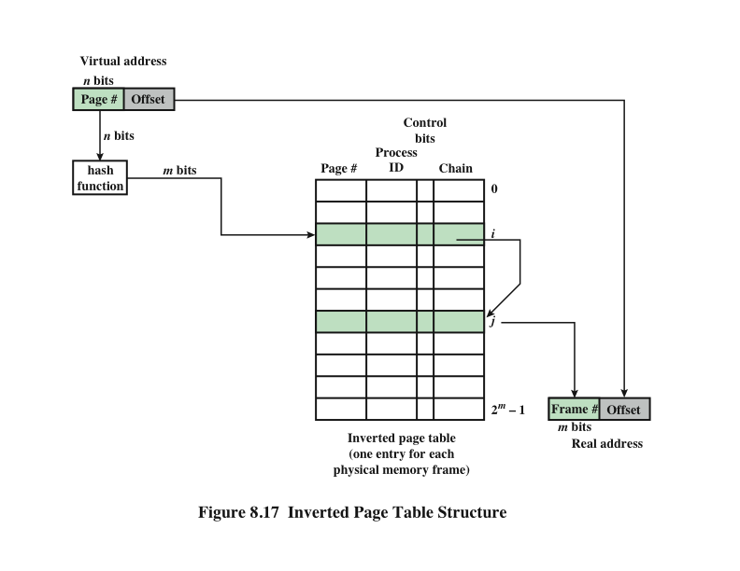
Inverted Page Table Structure
Notes:
An alternative approach to the use of one- or two-level page tables is the use of an inverted page table structure (Figure 8.17). Variations on this approach are used on the PowerPC, UltraSPARC, and the IA-64 architecture. An implementation of the Mach OS on the RT-PC also uses this technique.
In this approach, the page number portion of a virtual address is mapped into a hash value using a simple hashing function. The hash value is a pointer to the inverted page table, which contains the page table entries. There is one entry in the inverted page table for each real memory page frame rather than one per virtual page. Thus a fixed proportion of real memory is required for the tables regardless of the number of processes or virtual pages supported. Because more than one virtual address may map into the same hash table entry, a chaining technique is used for managing the overflow. The hashing technique results in chains that are typically short—between one and two entries. The page table’s structure is called inverted because it indexes page table entries by frame number rather than by virtual page number.

Slide 36
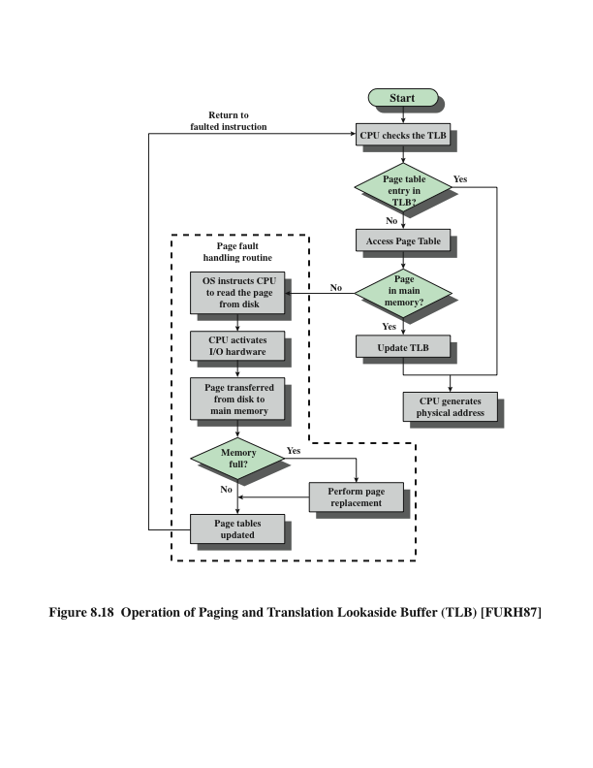
Operation of Paging and Translation Lookaside Buffer (TLB)
Notes:
In principle, then, every virtual memory reference can cause two physical memory accesses: one to fetch the appropriate page table entry, and one to fetch the desired data. Thus, a straightforward virtual memory scheme would have the effect of doubling the memory access time. To overcome this problem, most virtual memory schemes make use of a special cache for page table entries, usually called a translation lookaside buffer (TLB). This cache functions in the same way as a memory cache and contains those page table entries that have been most recently used. Figure 8.18 is a flowchart that shows the use of the TLB. By the principle of locality, most virtual memory references will be to locations in recently used pages. Therefore, most references will involve page table entries in the cache. Studies of the VAX TLB have shown that this scheme can significantly improve performance [CLAR85, SATY81].

Slide 37
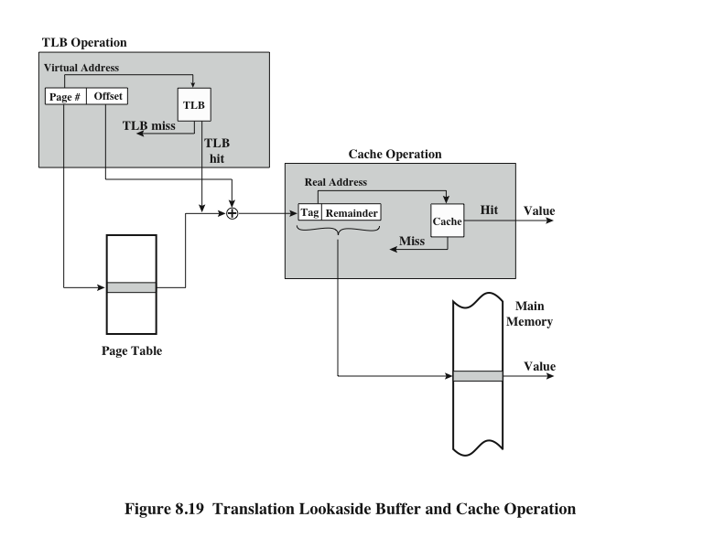
TLB and Cache Operation
Notes:
Note that the virtual memory mechanism must interact with the cache system (not the TLB cache, but the main memory cache). This is illustrated in Figure 8.19. A virtual address will generally be in the form of a page number, offset. First, the memory system consults the TLB to see if the matching page table entry is present. If it is, the real (physical) address is generated by combining the frame number with the offset. If not, the entry is accessed from a page table. Once the real address is generated, which is in the form of a tag and a remainder, the cache is consulted to see if the block containing that word is present (see Figure 4.5). If so, it is returned to the processor. If not, the word is retrieved from main memory.
The reader should be able to appreciate the complexity of the processor hardware involved in a single memory reference. The virtual address is translated into a real address. This involves reference to a page table, which may be in the TLB, in main memory, or on disk. The referenced word may be in cache, in main memory, or on disk. In the latter case, the page containing the word must be loaded into main memory and its block loaded into the cache. In addition, the page table entry for that page must be updated.

Slide 38
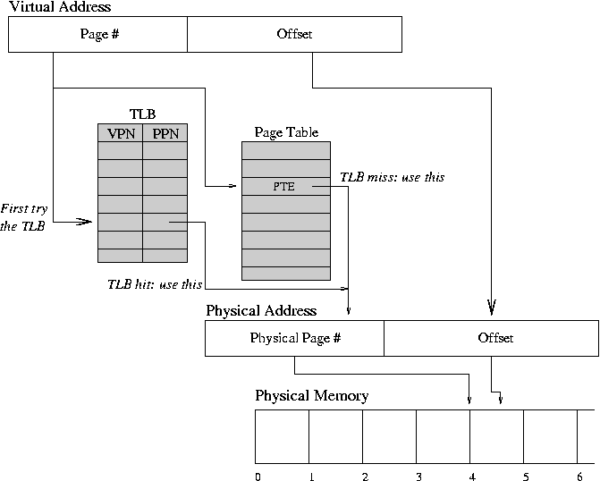
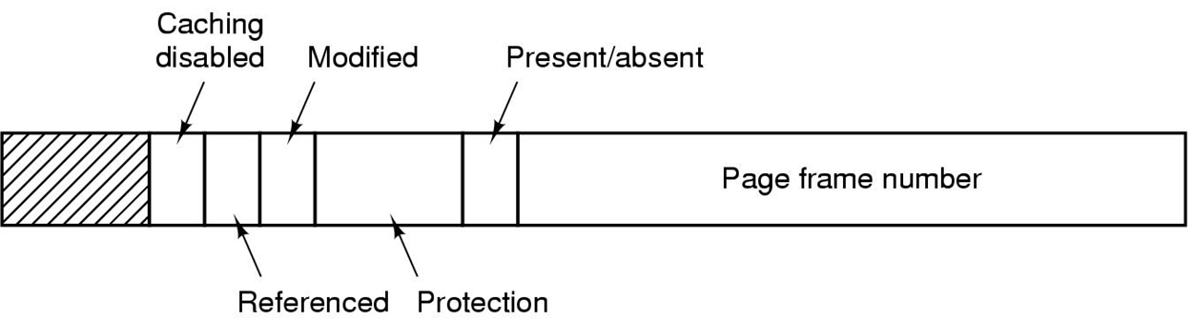
TLB Operation
Page table
Notes:
Note that the virtual memory mechanism must interact with the cache system (not the TLB cache, but the main memory cache). This is illustrated in Figure 8.19. A virtual address will generally be in the form of a page number, offset. First, the memory system consults the TLB to see if the matching page table entry is present. If it is, the real (physical) address is generated by combining the frame number with the offset. If not, the entry is accessed from a page table. Once the real address is generated, which is in the form of a tag and a remainder, the cache is consulted to see if the block containing that word is present (see Figure 4.5). If so, it is returned to the processor. If not, the word is retrieved from main memory.
The reader should be able to appreciate the complexity of the processor hardware involved in a single memory reference. The virtual address is translated into a real address. This involves reference to a page table, which may be in the TLB, in main memory, or on disk. The referenced word may be in cache, in main memory, or on disk. In the latter case, the page containing the word must be loaded into main memory and its block loaded into the cache. In addition, the page table entry for that page must be updated.

Slide 39
Segmentation
A segmented memory allows each table to grow or shrink independently of the other tables.
Tanenbaum, Modern Operating Systems 3 e, (c) 2008 Prentice-Hall, Inc. All rights reserved. 0-13-6006639

Slide 40


Segmentation
Usually visible to the programmer
Provided as a convenience for organizing programs and data and as a means for associating privilege and protection attributes with instructions and data
Allows the programmer to view memory as consisting of multiple address spaces or segments
Advantages:
Simplifies the handling of growing data structures
Allows programs to be altered and recompiled independently without requiring that an entire set of programs be re-linked and re-loaded
Lends itself to sharing among processes
Lends itself to protection
Notes:
There is another way in which addressable memory can be subdivided, known as segmentation. Whereas paging is invisible to the programmer and serves the purpose of providing the programmer with a larger address space, segmentation is usually visible to the programmer and is provided as a convenience for organizing programs and data and as a means for associating privilege and protection attributes with instructions and data.
Segmentation allows the programmer to view memory as consisting of multiple address spaces or segments. Segments are of variable, indeed dynamic, size. Typically, the programmer or the OS will assign programs and data to different segments. There may be a number of program segments for various types of programs as well as a number of data segments. Each segment may be assigned access and usage rights. Memory references consist of a (segment number, offset) form of address.
This organization has a number of advantages to the programmer over a non-segmented address space:
1. It simplifies the handling of growing data structures. If the programmer does not know ahead of time how large a particular data structure will become, it is not necessary to guess. The data structure can be assigned its own segment, and the OS will expand or shrink the segment as needed.
2. It allows programs to be altered and recompiled independently without requiring that an entire set of programs be re-linked and reloaded. Again, this is accomplished using multiple segments.
3. It lends itself to sharing among processes. A programmer can place a utility program or a useful table of data in a segment that can be addressed by other processes.
4. It lends itself to protection. Because a segment can be constructed to contain a well-defined set of programs or data, the programmer or a system administrator can assign access privileges in a convenient fashion.
These advantages are not available with paging, which is invisible to the programmer. On the other hand, we have seen that paging provides for an efficient form of memory management. To combine the advantages of both, some systems are equipped with the hardware and OS software to provide both.

Slide 41
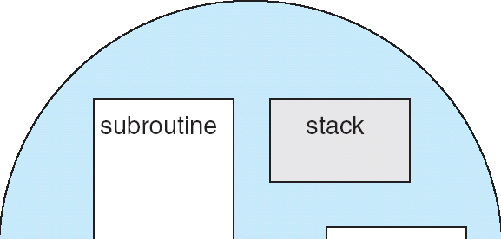
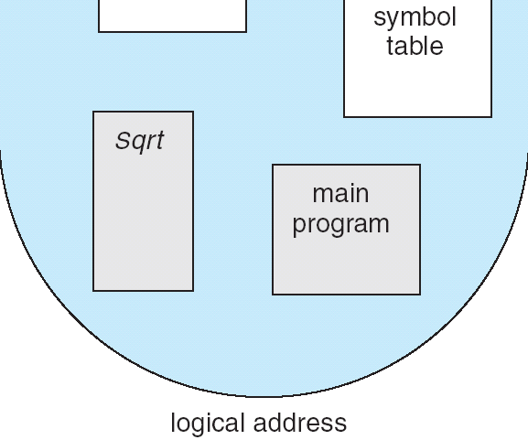
Segmentation
Memory-management scheme that supports user view of memory i.e. a collection of variable-sized segments, with no necessary ordering among segments
User's view of a program
Basic Method
Segments are numbered and are referred to by a segment number i.e. a logical address consists of a two tuple:
< segment-number, offset >
A program is a collection of segments, compiler constructs separate segments for :
The code
Global variables
The heap, from which memory is allocated
The stacks used, by each thread
The standard C library

Slide 42
Segment Tables
Corresponding segment in main memory
Each entry contains the length of the segment
A bit is needed to determine if segment is already in main memory
Another bit is needed to determine if the segment has been modified since it was loaded in main memory

Slide 43
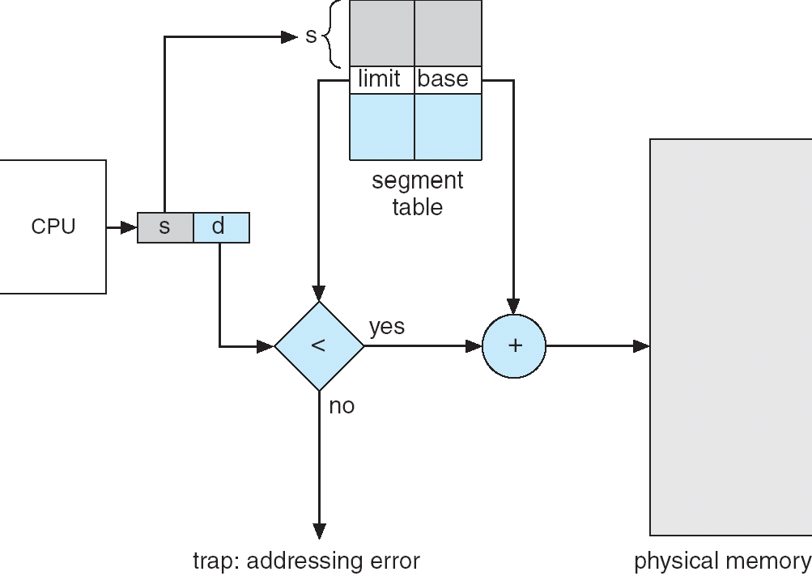
Segmentation
Hardware
Segment table – maps 2 dimensional physical addresses, each table entry has:
base – contains the starting physical address where the segments reside in memory
limit – specifies the length of the segment
Segment-table base register (STBR) points to the segment table’s location in memory
Segment-table length register (STLR) indicates number of segments used by a program;
Segment number s is legal if s < STLR
Segmentation hardware

Slide 44
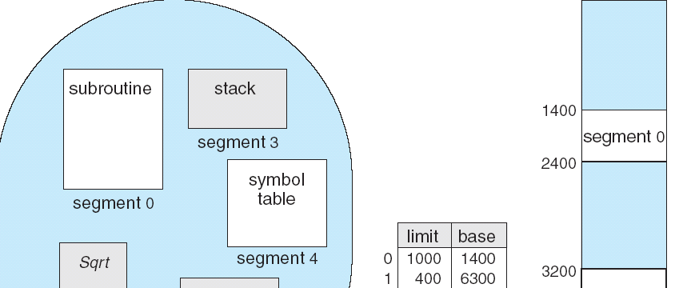
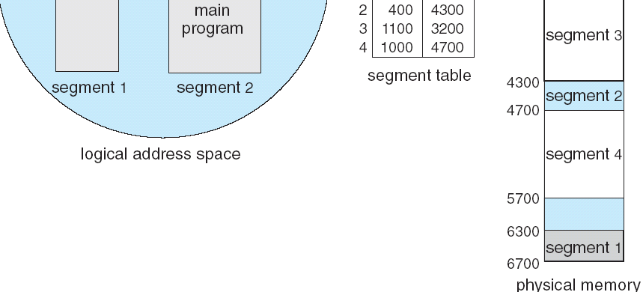
Segmentation
Segment 2 is 53 bytes long and begins at location 4300. Thus, a reference to byte 53 of segment 2 is mapped onto location 4300 + 53 = 4353
Segment 3, byte 852, is mapped to 3200 (the base of segment 3) + 852 = 4052
A reference to byte 1222 of segment 0 would result in a trap to the operating system, as this segment is only 1,000 bytes long
Example of Segmentation

Slide 45
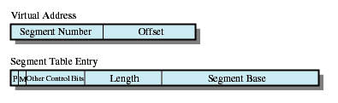
Segment Table Entries
P = Present Bit
M = Modified bit

Slide 46
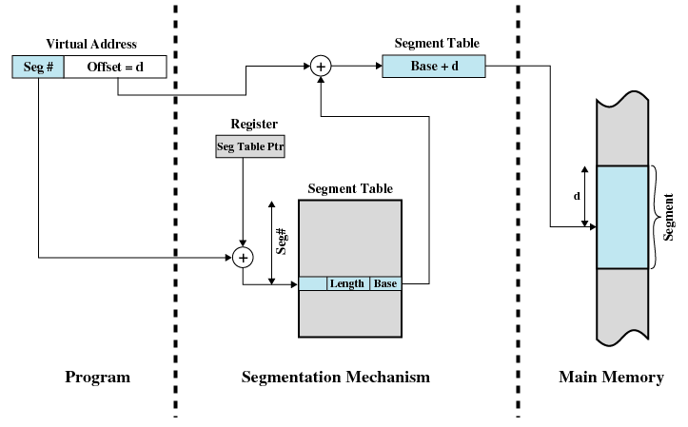
Address Translation in Segmentation System

Slide 47
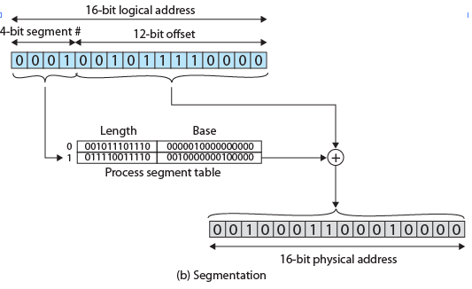
Address Translation in Segmentation System

Slide 48
Hardware is essentially the same as that used in the Intel 80386 and 80486 processors
Includes hardware for both segmentation and paging
Unsegmented unpaged memory
Virtual address is the same as the physical address
Useful in low-complexity, high performance controller applications
Unsegmented paged memory
Memory is viewed as a paged linear address space
Protection and management of memory is done via paging
Favored by some operating systems
Segmented unpaged memory
Memory is viewed as a collection of logical address spaces
Affords protection down to the level of a single byte
Guarantees that the translation table needed is on-chip when the segment is in memory
Results in predictable access times
Segmented paged memory
Segmentation is used to define logical memory partitions subject to access control, and paging is used to manage the allocation of memory within the partitions
Operating systems such as UNIX System V favor this view
Modern
Memory
Management
Notes:
The Pentium II includes hardware for both segmentation and paging. Both mechanisms can be disabled, allowing the user to choose from four distinct views of memory:
• Unsegmented unpaged memory: In this case, the virtual address is the same as the physical address. This is useful, for example, in low-complexity, high performance controller applications.
• Unsegmented paged memory: Here memory is viewed as a paged linear address space. Protection and management of memory is done via paging. This is favored by some operating systems (e.g., Berkeley UNIX).
• Segmented unpaged memory: Here memory is viewed as a collection of logical address spaces. The advantage of this view over a paged approach is that it affords protection down to the level of a single byte, if necessary. Furthermore, unlike paging, it guarantees that the translation table needed (the segment table) is on-chip when the segment is in memory. Hence, segmented unpaged memory results in predictable access times.
• Segmented paged memory: Segmentation is used to define logical memory partitions subject to access control, and paging is used to manage the allocation of memory within the partitions. Operating systems such as UNIX System V favor this view.

Slide 49
Combined Paging and Segmentation
Paging is transparent to the programmer
Segmentation is visible to the programmer
Each segment is broken into fixed-size pages

Slide 50
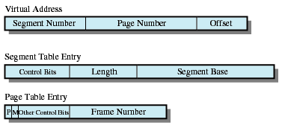
Combined Segmentation and Paging
P = Present Bit
M = Modified bit

Slide 51
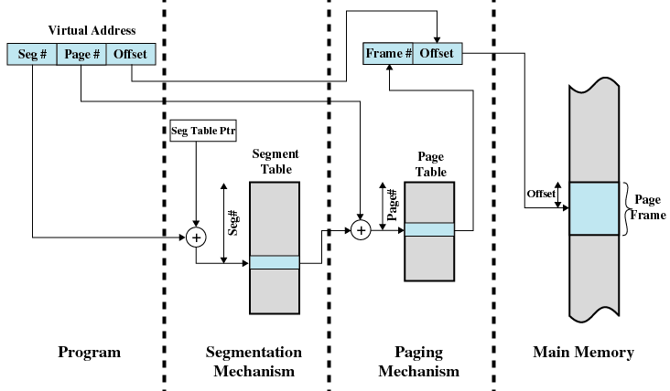
Address Translation in Segmentation / Paging System

Slide 52
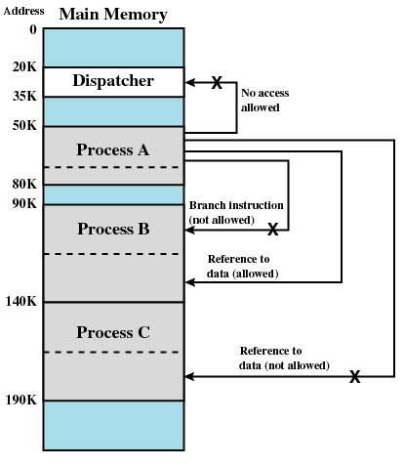
Protection Relationships between Segmentations
Notes:
What is Dispatcher?
-Dispatcher module gives control of the CPU to the process selected by the short-term scheduler; this involves: Switching context, Switching to user mode, Jumping to the proper location in the user program to restart that program.
Protection Mechanism
Segmentation lends itself to the implementation of protection and sharing policies. Because each segmentation table entry includes a length as well as a base address, a program cannot inadvertently access a main memory location beyond the limits of a segment. To achieve sharing, it is possible for a segment to be referenced in the segment tables of more than one process. The same mechanisms are, of course, available in the paging system. However in this case the page structure of programs and data is not visible to the programmer, making the specification of the protection and sharing requirements more awkward.

Slide 53
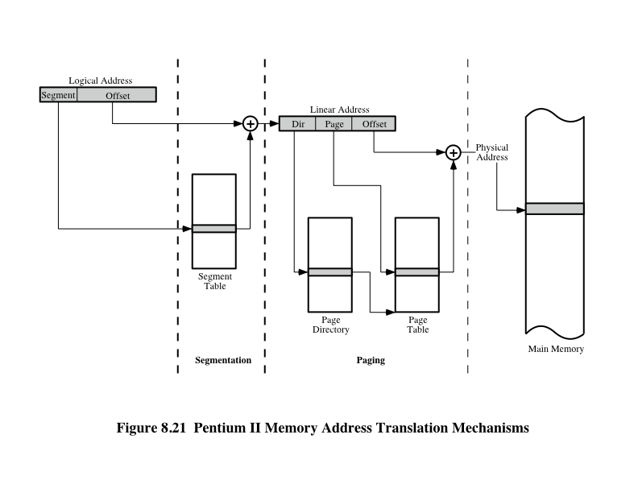
Pentium - Address Translation Mechanism
Notes:
Figure 8.21 illustrates the combination of segmentation and paging mechanisms. For clarity, the translation lookaside buffer and memory cache mechanisms are not shown.
Finally, the Pentium II includes a new extension not found on the 80386 or 80486, the provision for two page sizes. If the PSE (page size extension) bit in control register 4 is set to 1, then the paging unit permits the OS programmer to define a page as either 4 Kbyte or 4 Mbyte in size.
When 4-Mbyte pages are used, there is only one level of table lookup for pages. When the hardware accesses the page directory, the page directory entry (Figure 8.20d) has the PS bit set to 1. In this case, bits 9 through 21 are ignored and bits 22 through 31 define the base address for a 4-Mbyte page in memory. Thus, there is a single page table.
The use of 4-Mbyte pages reduces the memory-management storage requirements for large main memories. With 4-Kbyte pages, a full 4-Gbyte main memory requires about 4 Mbytes of memory just for the page tables. With 4-Mbyte pages, a single table, 4 Kbytes in length, is sufficient for page memory management.

